Slide 1
ECG Basics

Slide 2
History
1842- Matteucci - electrical activity from the heart of a frog
1887 - Waller - first electrical activity from human heart
1893 - Einthoven first used the term EKG ELEKTROKARDIOGRAMME
1901 - Einthoven built string galvanometer-based 3-lead EKG machine
1924 - Einthoven won Nobel Prize
1934-38 - Wilson invented the central terminal. Precordial leads were born.

Slide 3
1942 - Goldberg used the central terminal with augmentation. Augmented unipolar leads were born.
1954 - AHA standardized 12-lead as we know it now

Slide 5
Willem Einthoven

Slide 6
Cardiac impulse formation and conduction

Slide 7
Cardiac cycle
SYSTOLE | DIASTOLE
ELECTRICAL
ACTIVATION | RECOVERY
EXCITATION | RECOVERY
DEPOLARIZATION | REPOLARIZATION
MECHANICAL
SHORTENING | LENGTHENING
CONTRACTION | RELAXATION
EMPTYING | FILLING

Slide 9
A. 1st of four cells is electrically activated. Spread of depolarization toward the positive electrode produces a positive deflection
B. Cells are in their depolarized state
C. Repolarization begins in the same cell in which depolarization was initiated and this wave spreads into the adjoining cells. This produces the oppositely directed negative waveform on the ecg.

Slide 10
Electrocardiogram
An ECG is the recording (gram) of the electrical activity (electro) generated by the cells of the heart (cardio) that reaches the body surface.
Electrical activity → cardiac contraction

Slide 11
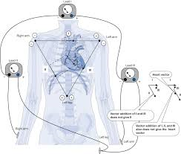
The electrocardiograph is a sophisticated galvanometer – detects and records changes in electromagnetic potential
Has a positive pole and a negative pole

Slide 12
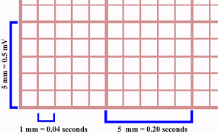
Electrocardiographic paper
Divided into small and large squares
1 small square = 1mm
1 large square = 5 mm
Paper speed – 25 mm/s
5 large squares – 1 s
1 large square – 0.20 s
1 small square – 0.04 s

Slide 13
WHAT DOES AN ECG ACTUALLY MEASURE?
Voltage → vertical axis
Time → horizontal axis

Slide 14
The electrical field of the heart
The heart is situated in the centre of the electrical field which it generates
The intensity of this electrical field diminishes algebraically with the distance from its centre
Distances >15 cm decrement in intensity of electrical field is hardly noticeable

Slide 15
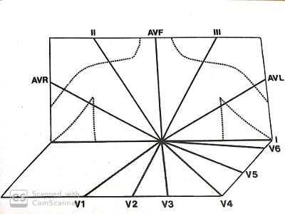
The conventional ECG leads
1. Frontal plane leads : standard leads I, II and III and leads AVR, AVL and AVF
2. Horizontal plane leads : precordial leads V1 to V6

Slide 16
Standard limb leads: I, II and III
The electrode placement is referred to as Einthoven’s triangle

Slide 18
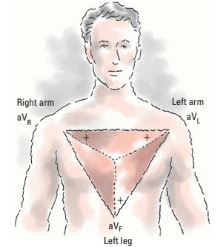
Unipolar limb leads
Augmented limb leads are unipolar leads and include aV_{R}, aV_{L} and aV_{F.}
The letter ‘a’ stands for ‘augmented’ and letters R, L, and F stand for positive electrode position of the lead.
They measure electrical activity between one limb and a single electrode.
While aV_{R} provides no specific view, aV_{L} and aV_{F} show electrical activity from lateral and inferior wall of the heart, respectively.
aV_{R} produces negative deflection and aV_{L} and aV_{F} produce positive deflections.

Slide 19
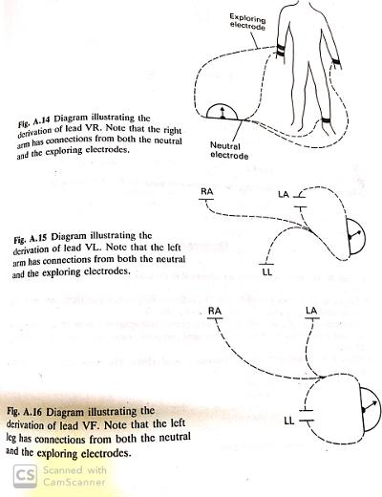

Slide 20
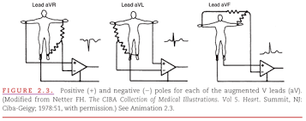

Slide 21
Horizontal plane leads

Slide 25
Standard sites unavailable
Because of patient pathology – amputation, burns or bandages
The electrodes should be positioned as closely as possible to the standard sites

Slide 26
Specific cardiac abnormalities
In the presence of tachycardia alternative lead placement may produce a lead that reveals atrial activity
A. moving positive V1 electrode one ICS above its standard site
B. using this site for the positive V1 electrode and the xiphoid process of the sternum for the negative V1 electrode
C. using a transesophageal site for the positive v1 electrode

Slide 27
In dextrocardia the right and left arm electrodes should be reversed and the precordial leads should be recorded from rightward oriented positive electrodes
RV hypertrophy and infarction best detected by in V3R or V4R

Slide 28
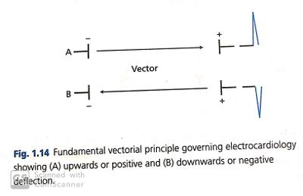
The basic action of electrocardiograph
Sequential depolarization of cardiac muscle tissue causes a depolarization front which results in an electrical current
Electrocardiographic current forms an electromagnetic force or vector which can be detected and recorded by the electrocardiograph

Slide 33
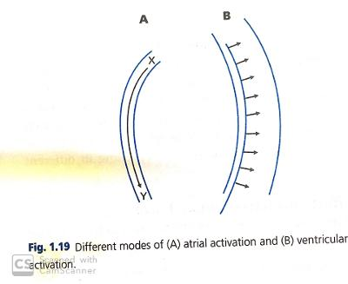
Modes of atrial and ventricular activation
Atrial chamber – thin walled and not equipped with specialized conduction system of the ventricles
Activation occurs longitudinally and by contiguity

Slide 34
Activation of ventricles – effected through the specialized and highly efficient conduction system
The muscle is activated from endocardial to epicardial surface
Excitation occurs transversely and the whole chamber activated near synchronously

Slide 35
With longitudinal form of atrial activation – proximal parts are activated before the distal parts
Sequential and longitudinal form favors potential out of phase
Easy to potentially induce atrial fibrillation.

Slide 36
Transverse form of ventricular activation favors a synchronous or near-synchronous state
Any regional section of the ventricular wall will be in a state of excitation or state of refractoriness
In-phase state – one of the factors which militates against development of ventricular fibrillation

Slide 37
Waveforms

Slide 38
Deflection | What it represents
P wave | Atrial depolarisation
PR interval | Time delay between atrial depolarisation and ventricular activation
QRS complex | Ventricular depolarisation
ST segment (isoelectric) | Electrical plateau of ventricular activation
T wave | Ventricular repolarisation
QT interval | Total time for ventricular depolarisation and repolarisation
U wave | Possibly septal or late ventricular repolarisation

Slide 39
Interpretation of the Normal ECG
1. rate and regularity
2. P wave morphology
3. PR interval
4. QRS complex morphology
5. ST- segment morphology
6. T wave morphology
7. U wave morphology
8. QTc interval
9. Rhythm

Slide 40
Rate and regularity

Slide 41
Rule of 300
Identify the QRS complex
Count the number of large boxes between one QRS wave and the next one
Divide 300 by this number
The resultant number is the heart rate
No. of large squares between QRS complexes | Heart rate (bpm)
1 | 300
2 | 150
3 | 100

Slide 42
Number of large boxes between one QRS wave and the next one is 6
300/6=50 beats per minute

Slide 43
10 second rule
This is particularly useful when the rhythm is irregular
Obtain a 6-second strip
Count the number of P waves in the strip
Multiply the number by 10 to get the number of atrial beats per minute
Repeat the same for ventricular rate by counting the number of R waves and multiplying by 10

Slide 44
10 second rule example
Number of R waves in the 6-second strip: 7
Ventricular heart rate—7×10=70 beats per minute

Slide 45
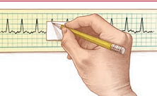
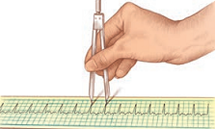
Rhythm
Atrial rhythms are evaluated by measuring intervals between consecutive P waves
Ventricular rhythms are evaluated by measuring intervals between consecutive R waves
In the absence of R waves, use the Q wave
Paper-and-pencil method or the caliper method can be used for measuring the rhythms.
Paper-and-pencil method
Caliper method

Slide 46
P wave morphology
Represents atrial depolarization (conduction of electrical impulse through the atria)
Location: Precedes the QRS complex
Amplitude: no more than 0.2 mV in frontal plane and no more than 0.1 mv in transverse plane
Duration: <0.12 seconds
Configuration: Usually rounded and upright
Deflection: entirely positive or negative in all leads except V1 and V2

Slide 47
PR interval
The PR interval represents atrial impulse from the atria through AV node which is controlled by the balance between sympathetic and parasympathetic divisions
Location: From the beginning of the P wave to the beginning of the QRS complex
Duration: in childhood 0.10 to 0.12 second
in adolescence 0.12 to 0.16 second
in adulthood 0.12−0.20 seconds

Slide 48
Morphology of the QRS complex
General contour : QRS complex higher frequency signals causing its contour to be peaked rather than rounded

Slide 49
Nomenclature

Slide 50
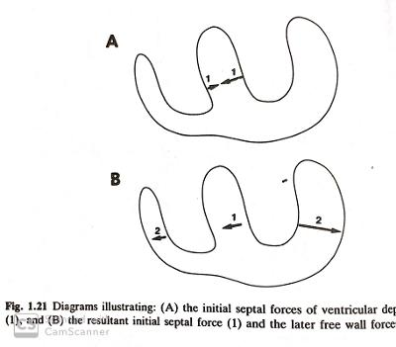
Genesis of QRS complex
Activation of ventricles may be depicted as a small initial vector from left to right through the interventricular septum followed by a larger vector from right to left through the free wall of the left ventricle

Slide 51
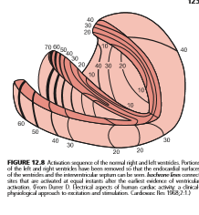
The effect on a left and right oriented lead

Slide 52
Q waves- normal duration limits
LIMB LEADS |  | PRECORDIAL LEADS
LEAD | UPPER LIMIT | LEAD | UPPER LIMIT
I | <0.O3 | V1 | ANY Q
II | <0.03 | V2 | ANY Q
III | NONE | V3 | ANY Q
aVR | NONE | V4 | <0.02
aVL | <0.03 | V5 | <0.03
aVF | <0.03 | V6 | <0.03

Slide 53
The absence of small Q waves in leads V5 and V6 should be considered abnormal
Q wave of any size is normal in leads III and aVR because of their right ward orientations

Slide 54
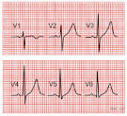
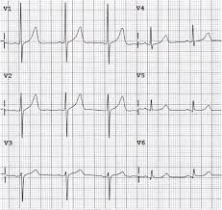
R waves
R wave normally increases in amplitude and duration from lead V1 to lead V4 or V5
Loss of normal R wave progression from lead V1 to lead V4 indicates loss of left ventricular myocardium

Slide 55
S waves
It is large in V1, larger in V2 and progressively smaller from V3 through V6

Slide 56
QRS interval
Normally ranges from 0.07 to 0.11 second
Slightly longer in males than in females

Slide 57
The electrical axis
The major electrical forces occurs in the apical region of the LV and the adjacent free wall and are directed dominantly downwards and to the left
The mean or dominant direction of all these vectors is known as the mean vector and expressed electrocardiologically as the mean QRS axis.

Slide 60
Standard lead triaxial reference system
Lead axes of the three standard leads form an equilateral triangle
Each angle of the triangle 60 degrees
The lead axes of Einthoven’s triangle may be transposed so that they bisect each other while maintaining their orientation

Slide 61
The unipolar lead triaxial reference system
It is so constructed that their lead axes geometrically bisect the angles of the equilateral triangle formed by the standard leads
These leads may be transposed so that they bisect each other while maintaining their orientation
They also form triaxial reference system – each lead separated by 60 degrees
When these two triaxial reference systems are combined and superimposed upon each other, they form a hexaxial reference system

Slide 62
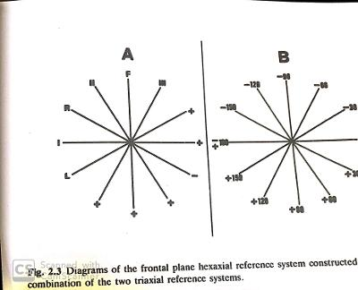

Slide 63
Naming the degrees of hexaxial reference system
By convention the upper hemisphere are labelled negative whereas in lower half are labelled positive degrees
The one exception is lead AVR positive pole located at -150

Slide 64
Graphing the electrical axis
If two lead axes are at right angles to each other then one records a maximal deflection as a result of the parallel vector, the other must record a nil or equiphasic deflection since the vector must be at right angles to this lead

Slide 65
Derivation of the frontal plane axes
1. examine the six frontal plane leads
2. determine the most equiphasic QRS deflection
3. identify the lead perpendicular to the transitional lead
4. consider the predominant direction of the QRS complex in the lead identified in step 3

Slide 67
Left axis deviation
Normal variation
Inferior wall myocardial infarction (Ml)
Left anterior hemiblock
Wolff-Parkinson-White syndrome
Mechanical shifts (ascites, pregnancy, tumors)
Left bundle branch block
Left ventricular hypertrophy
Aging

Slide 68
Right axis deviation
Normal variation
Lateral wall Ml
Left posterior hemiblock
Right bundle branch block
Emphysema
Right ventricular hypertrophy

Slide 69
Morphology of ST segment
ST segment represents the period during which the ventricular myocardium proceeds through the preliminary two phases of repolarisation: phases 1 and 2, following its depolarization in phase 0

Slide 71
T wave
T wave represents ventricular recovery or repolarization
Location: Follows the S wave
Amplitude: do not exceed 0.5 mV in any limb lead or 1.5 mV in any precordial lead
Configuration: Round and smooth
Deflection: Upright in leads I, II and V₃to V₆; inverted in lead aV_{R}; variable in other leads

Slide 72
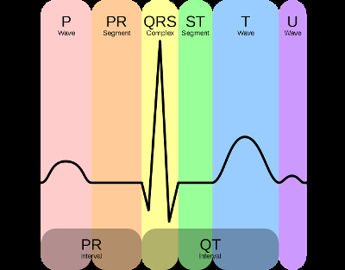
U wave
The U wave may not appear in all rhythm strips.
If present, it represents the recovery period of the Purkinje or ventricular conduction fibers
Configuration: Typically upright and rounded
Prominent U wave indicates hypercalcemia, hypokalemia or digoxin toxicity

Slide 73
QT interval
QT interval determines ventricular depolarization and repolarization
Location: Extends from the beginning of the QRS complex to the end of the T wave
Duration: 0.36−0.44 seconds; varies according to age, sex, and heart rate
When the rhythm is regular, duration of QT interval should not be greater than half the distance between consecutive R waves.
Length varies according to the heart rate. Faster the heart rate, shorter is the QT interval.

Slide 74
QTc interval
QT interval varies inversely with the cardiac rate
To ensure recovery from one cardiac cycle before the next cycle begins the duration of recovery must decrease as the rate of activation increases
Bazett formula: QTc = QT/ sq root of RR
Upper limit of Qtc interval is approximately 460ms

Slide 75
Abnormality in duration of QT interval indicates myocardial problems
Prolonged QT: Increases the risk of a life-threatening arrhythmia known as torsades de pointes
Certain medications also increase the QT interval such as amiodarone, amitriptyline, chlorpromazine
Prolonged QT may also indicate congenital conduction system defect present in certain families
Short QT interval: Digoxin toxicity or hypercalcemia

Slide 76
Normal standardization
Conventionally standardized so that 1 mv will result in 10 mm deflection

Slide 77
Overdamping
When the pressure of the writing stylus is too firm on the platform the excursions will be retarded
The deflections may be inscribed more slowly so that they become fractionally wider
The deflections may be diminished in amplitude

Slide 78
Underdamping
When the pressure of the writing stylus is too loose on the platform
The deflections may be inscribed more rapidly so that they become fractionally narrower
The deflections may be increased in amplitude

Slide 79
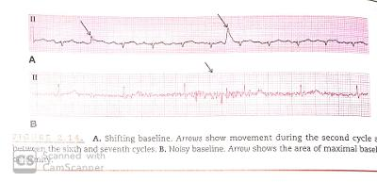
Important points to consider when recording an ECG
Electrodes should be selected for maximum adhesiveness and minimum discomfort, electrical noise and skin electrode impedance
Effective contact between electrode and skin is essential sites with skin irritation should be avoided
Poor contact may produce baseline wander when the instability occurs gradually or shifting baseline when the instability occurs abruptly

Slide 80
Ecg paper speed is typically 25mm per second. A faster speed provides clear depiction of wave morphology and slower speed to facilitate rhythm analysis
Calibration of ecg signal is typically 1 mV = 10mm. When large QRS waveform amplitudes require that calibration be reduced to 1 mV = 5 mm.

Slide 81
Case presentation
A 63-year-old male with history of severe COPD, hypertension, and coronary artery disease presented with worsening dyspnea of one-week duration and vomiting and fever for two days.
Vitals stable
Temperature of 100.6 f (38.1 c)
Oxygen saturation was 96% on 4L Nasal Cannula (NC).
Physical examination crackles heard over left lower hemithorax.

Slide 82
Laboratory studies showed white blood cells count of 12.3 K/μL, hemoglobin level of 15.3 g/dL, and troponin level of 0.04 ng/mL.
Electrolytes panel showed no abnormality.
Chest radiograph showed left lower lobe pneumonia with small pleural effusion.
Angiogram Computed Tomography (CT) of the chest was negative for pulmonary embolism.

Slide 83
Baseline ECG showed sinus tachycardia with old T-wave inversions in inferolateral leads
Few hours later patient developed hypotension and hypoxemic respiratory failure and intubated
Physical examination revealed blood pressure of 95/49 mmHg and heart rate of 78 bpm with decreased breath sounds over the right anterior chest along with hyperresonance to percussion.
Telemetry monitor showed ST-segment elevation.

Slide 86
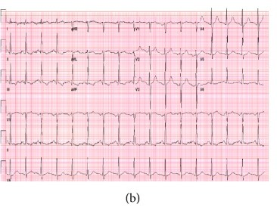
Needle decompression followed by chest tube placement rapidly improved the clinical status

Slide 88
Possible mechanisms-cardiac rotation, acute right ventricular dilatation from hypoxia, decrease in preload due to increased intrathoracic pressure, and decreased coronary flow reserve.
Previous case reports of ECG changes in tension pneumothorax described ST changes in the inferior and lateral leads.
In the current case, there was ST elevation in leads V1–V3, with reciprocal ST depressions in the inferior leads.

Slide 89
The possible underlying mechanisms in this patient with tension pneumothorax could include hypotension induced subendocardial ischemia, compression of the right ventricle by the air accumulated in the right pleural cavity and increased pulmonary artery pressure with right ventricular strain.
This case highlights the importance of being aware of tension pneumothorax induced ECG changes as well as the paramount role bedside physical examination plays in emergent management

